Slide 1
Practical Data Science Assignment 2
Heart Disease Prediction

Slide 2
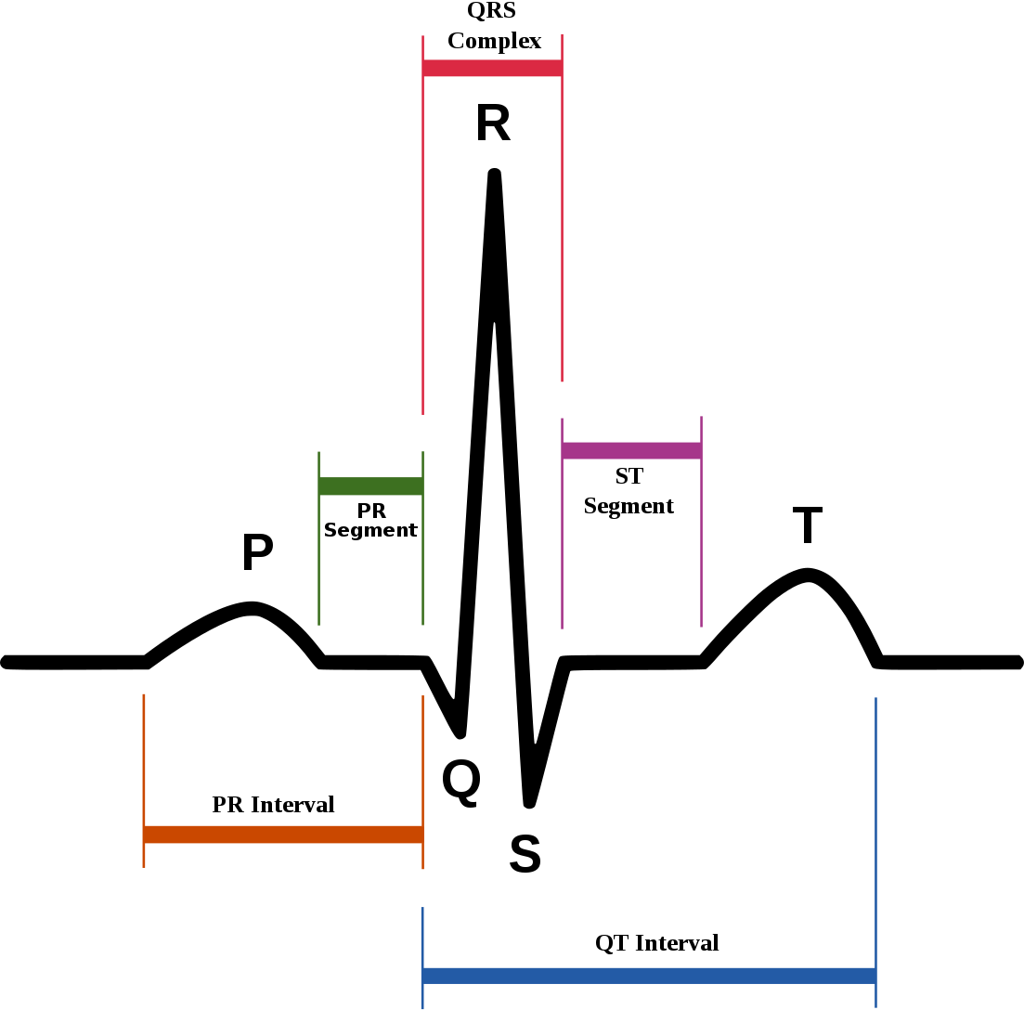
Heart Disease Dataset (UCI Machine Learning)
Hypothesis – Predicting the presence/absence of heart disease
Age (Continuous)
Sex
Chest pain type (4 values)
Resting blood pressure (Continuous)
Serum cholesterol in mg/dl (Continuous)
fasting blood sugar > 120 mg/dl ((Continuous)
resting electrocardiographic results (values 0,1,2)
maximum heart rate achieved (Continuous)
exercise induced angina
Old Peak = ST depression induced by exercise relative to rest (Real)
the slope of the peak exercise ST segment (Ordered)
number of major vessels (0-3) coloured by fluoroscopy
Thalassemia: 3 = normal; 6 = fixed defect; 7 = reversible defect
Target Variable
Heart Disease - Yes/No (Binary)
No of instances - 270

Slide 3
Machine Learning Model
Data Preparation – No missing Values or Noise present. Whole dataset is used to create model
Train/Test Ratio – 70-30
1. Decision Tree Classification
Accuracy on Test – 0.75
2. Random Forest Classifier
Accuracy on test – 0.76
 | precision | recall | score
avg | 0.77 | 0.75 | 0.76
 | precision | recall | score
avg | 0.77 | 0.77 | 0.77

Slide 4
Machine Learning Model
3. K Nearest Neighbors
Accuracy on Test – 0.98
Conclusion –
Decision Tree and Random forest has 77% accuracy.
K Nearest Neighbors is overfitting of data. We’ll select random forest for Heart disease prediction.
 | precision | recall | score
avg | 0.99 | 0.99 | 0.99

